Slide 1

Electronic communication with our users
Oslo – 26.09.2017
Produsentuavhengig legemiddelinformasjon for helsepersonell

Slide 2
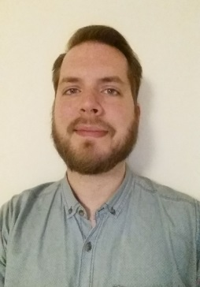
Petter Wiken Dahl
Leader, RELIS Vest (Western Norway)
Master of Pharmacy
Bachelor of Communications
E-mail: petter.wiken.dahl@helse-bergen.no
Produsentuavhengig legemiddelinformasjon for helsepersonell

Slide 3

Brief walkthrough
Who are our users?
Which electronic communication do we use?
Current technology
Websites – hosted by us
Websites – social media
Looking forward: Websites
Looking forward: Chat
Looking forward: Appssider

Slide 4

Who are our users?
For starters…

Slide 5
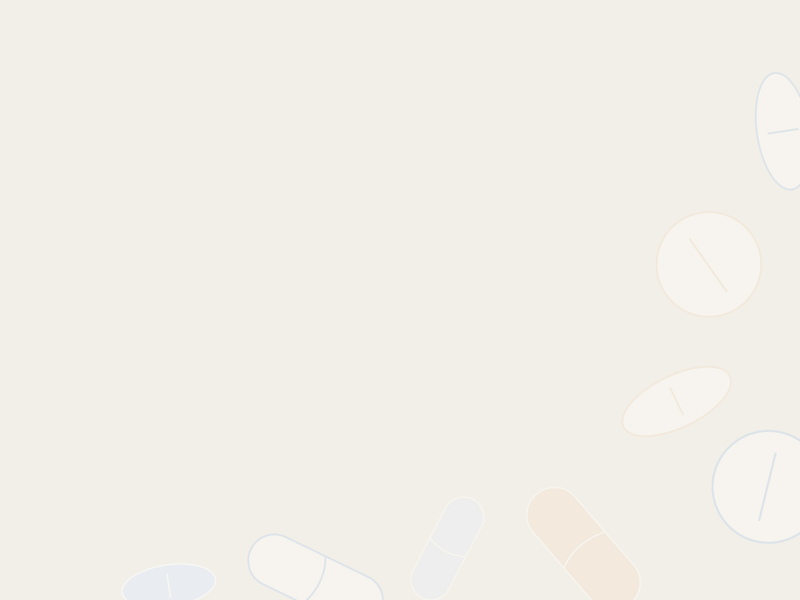





Who are our users?
Health professionals:
Medical doctors pharmacists nurses
The public:
Pregnant women breast feeding women

Slide 6

Which electronic communication do we use?
So we know our user base, but…

Slide 7

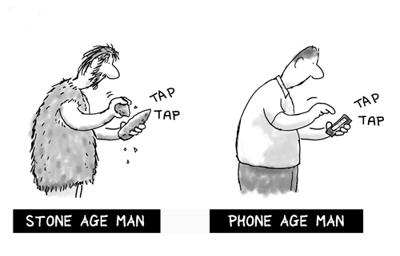
Which electronic communication do we use?
Telephone
E-mail
Websites
Chat
Mobile platforms
Apps
Fax??

Slide 8
Telephone
Let’s look closer!

Slide 9
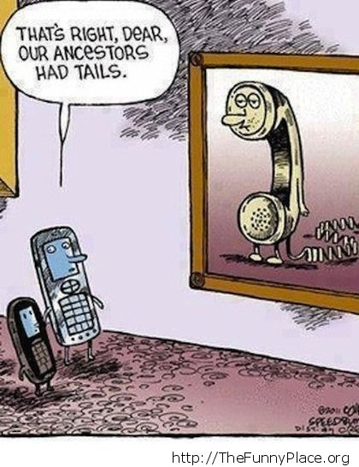
Telephone
5 separate phone numbers – one per centre, and the TMM line
Advantages:
  Internet problems? No problem!
  Contact us without a PC nearby
  High sense of active conversation
  Able to supply additional information
Disadvantages:
  Noise disturbances
  Speech issues
  No conversation logging.

Slide 10
E-mail
Let’s look closer!

Slide 11
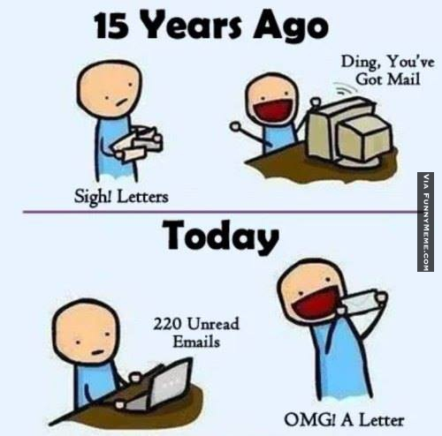
E-mail
Widespread use since 1990s, first use 1960s!
Advantages:
  Electronic (paperless society)
  Universal
  Instant
  Multiple recipients
  Conversation log
  Searchable
Disadvantages:
  Hackers – not a secure platform!
  Portal for viruses, adware, spyware
  Spam
  Mail: low sense of active conversation.

Slide 12
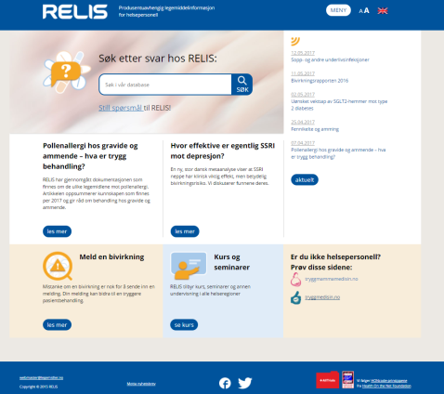
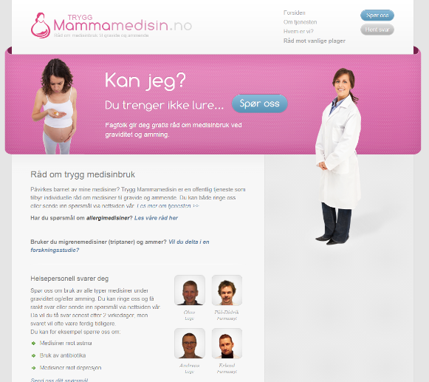
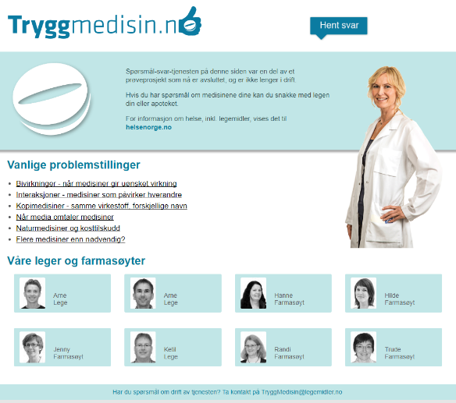
Our hosted websites
Let’s look closer!
www.relis.no
www.tryggmammamedisin.no
www.tryggmedisin.no

Slide 13
www.relis.no
For health professionals
Free service
Database search
Submit questions
Phone, mail, e-mail contact info
Report adverse drug reactions
Read our published articles
RELIS news, courses and seminars
Mandate, centres, employees.

Slide 14

www.tryggmammamedisin.no
Public – pregnant & breastfeeding
Free service
Submit questions
Pick up responses
Phone service info
Topic info: pains, allergies, stuffy nose, nausea, dyspepsia
Mandate, centres, employees.

Slide 15

www.tryggmedisin.no
Free public service, currently defunct
Previously – submit questions on drugs (any topic)
Closed mid-August 2017
Info on drug topics:
  Adverse drug reactions
  Interactions
  Generic drugs
  Drug news in media
  Herbal remedies / supplements
  Polypharmacy
Mandate, centres, employees.

Slide 16
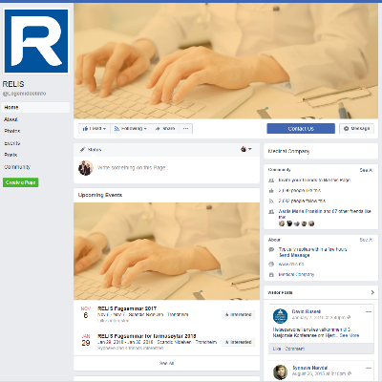
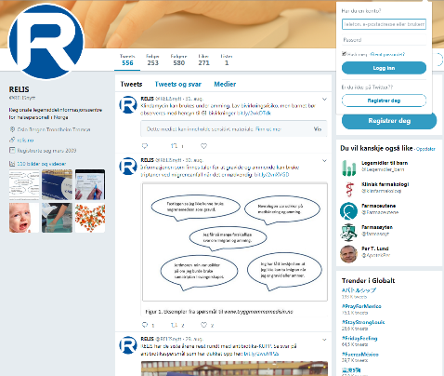
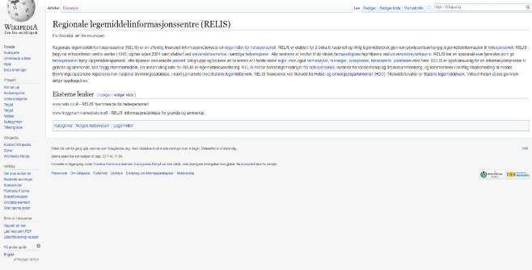
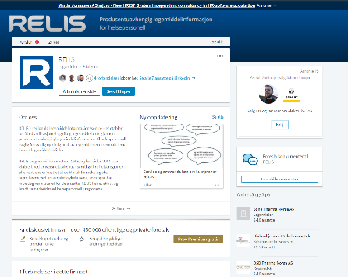

Our social media websites
Let’s look closer!
www.facebook.com
www.twitter.com
www.wikipedia.org
www.linkedin.com

Slide 17


www.facebook.com/legemiddelinfo
Main social media platform
Current events, projects, seminars
Links to published articles
Chat option…?
12th hit in Google search
2685 followers, 2693 likes
(follow and like us and our posts!)

Slide 18

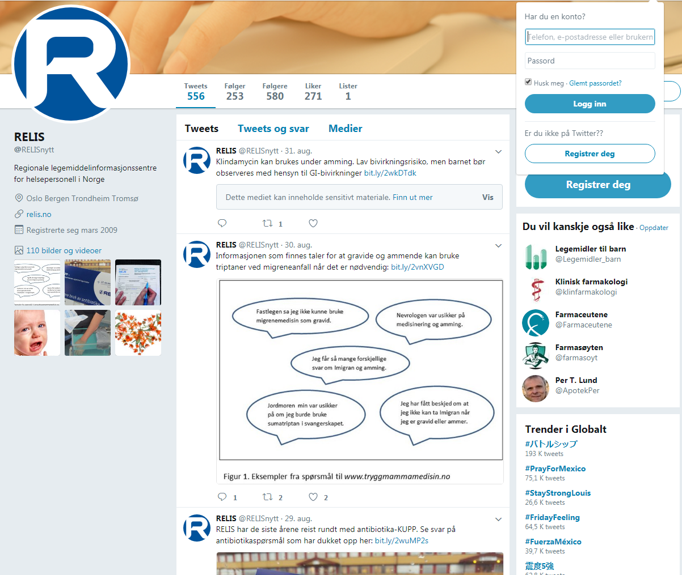
www.twitter.com/relisnytt
Secondary social media platform
Links to published articles and news
18th hit in Google search
581 followers
(follow us, heart and retweet posts!)

Slide 19


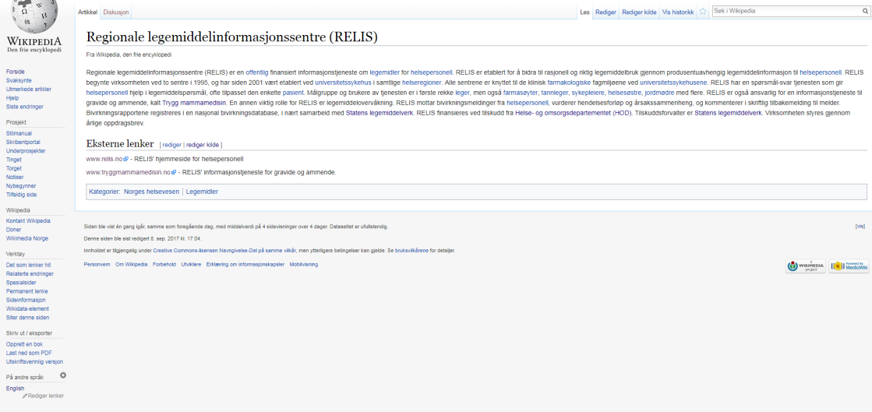

en.wikipedia.org/wiki/RELIS no.wikipedia.org/wiki/Regionale_ legemiddelinformasjonssentre_(RELIS)
Public information
Dictionary style
Direct links to our main sites
Wiki: Editable by anyone
5th hit in Google search!
Now also in English!

Slide 20

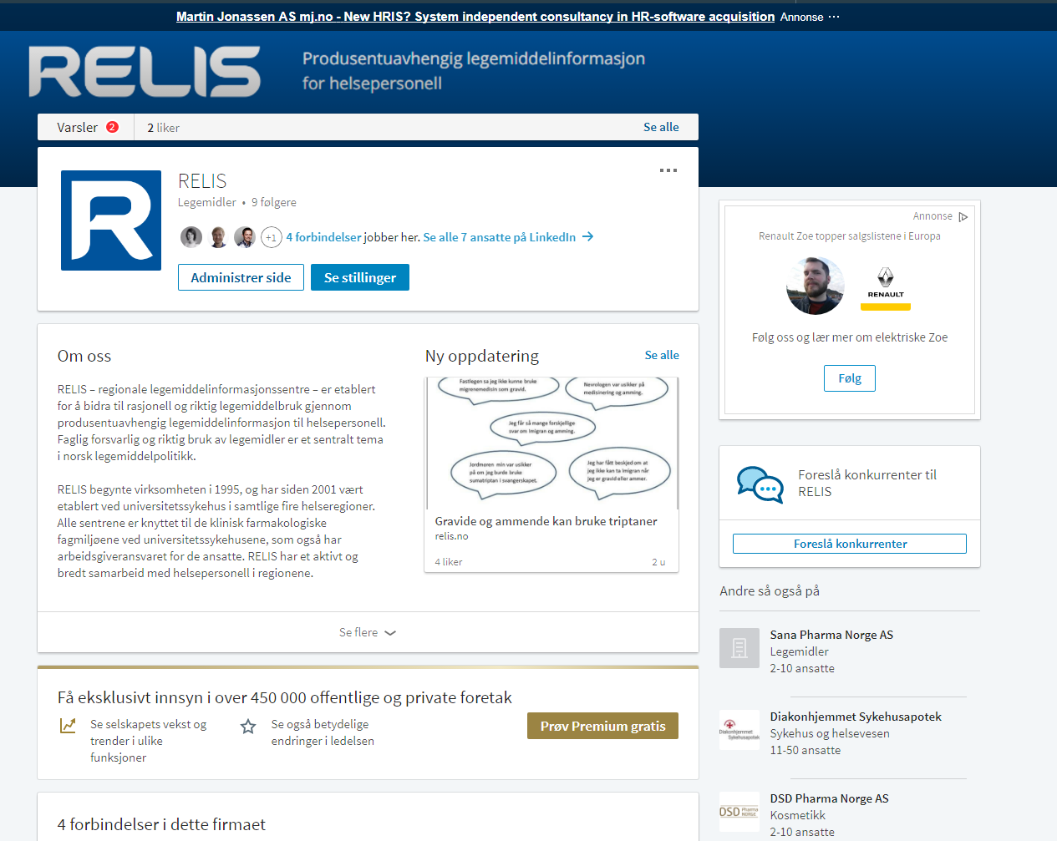
www.linkedin.com/company/13386811/
Social media platform for professionals
Company history
Links to LinkedIn employees (currently 7)
Organic reach of 100-150 per post
New in August 2017
Norwegian and English pages
10 followers
RELIS-employees: join us!
Others: follow us!

Slide 21

The future: websites, chat, apps
So we know about the present. What about…

Slide 22
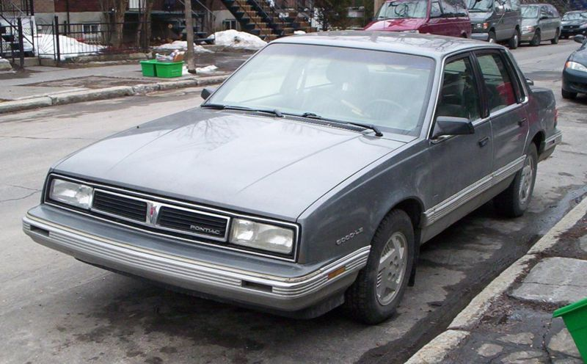

Cars and chairs – how do they work?
Basic functions
Reliable
Maintenance costs
Outdated design
Harder to incorporate new design in an old frame.

Slide 23



Cars and chairs – how do they work?

Slide 24
Cars and chairs – how do they work?
More advanced functions
Interconnectivity
Well-designed
User friendly
Multi platform (tablets/phones)
Still reliable!
Good investment.

Slide 25
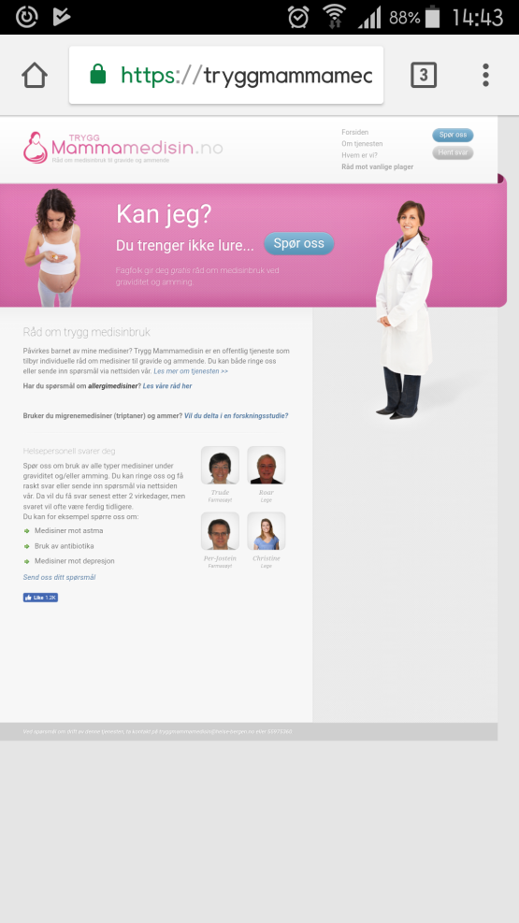
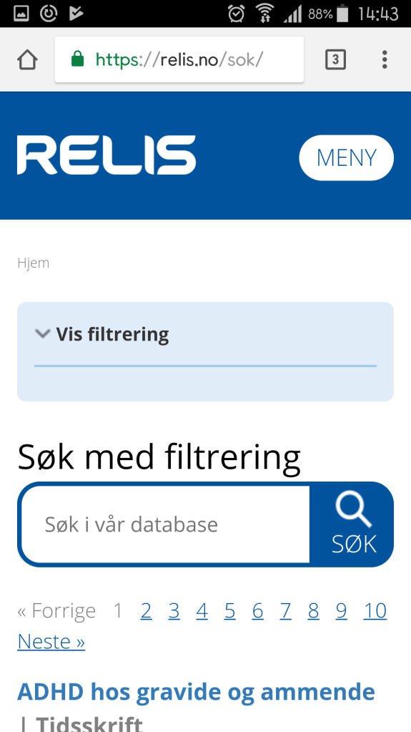


Multiplatform websites
Reasonable text size
Zoomable
Easily accessible menu
No dead space
Frame filling

Slide 26
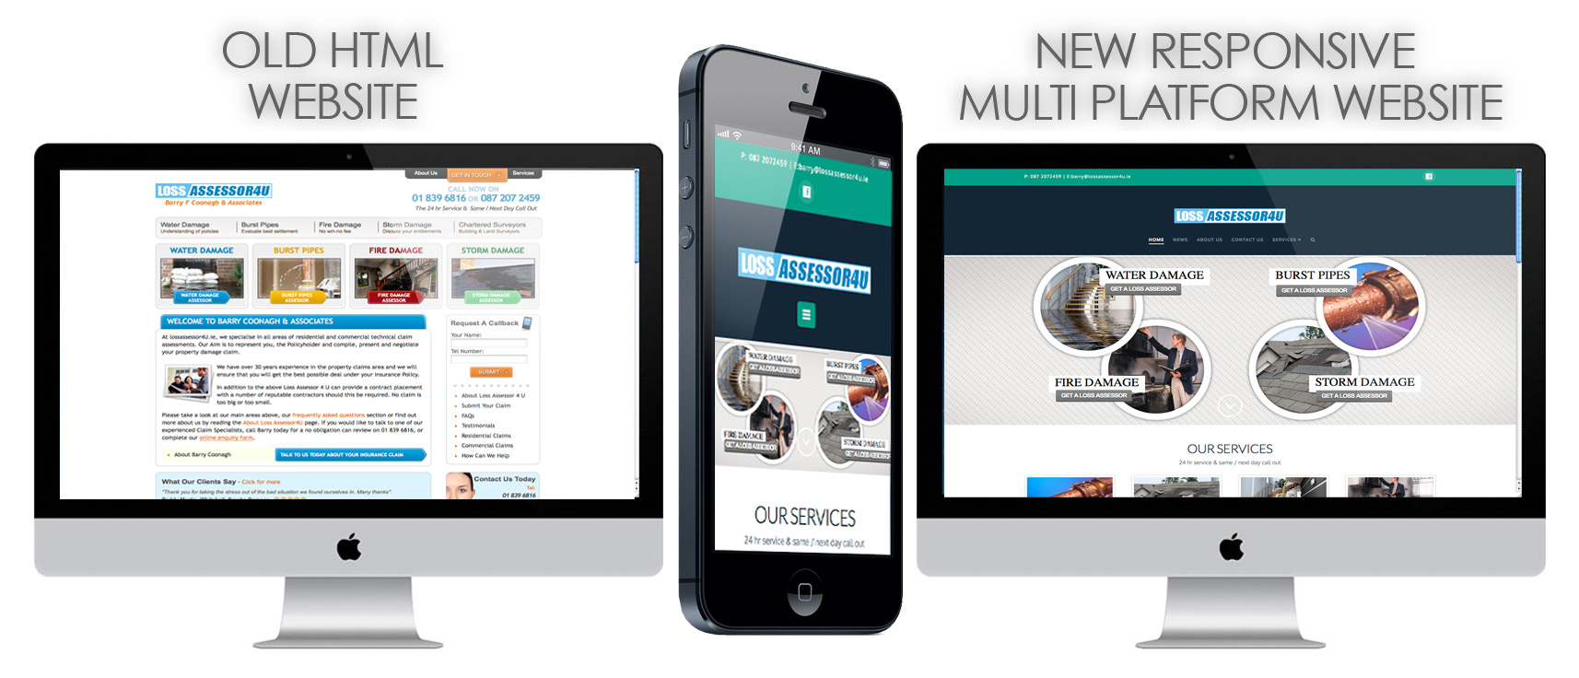
Actual example of website upgrade

Slide 27
A vision of a new/upgraded website
New design (professional appeal)
Multiplatform friendly
Phone service clearly visible
FAQ clearly visible
Phone text message (SMS) response system
Updated employee info.

Slide 28
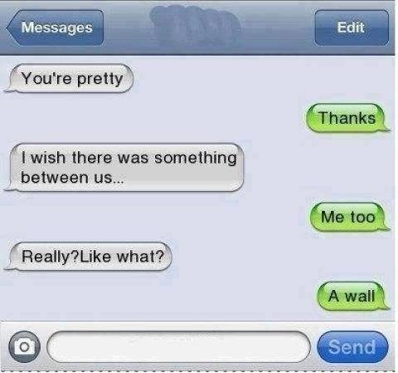
Chat
Other potential ways of electronic communication?

Slide 29
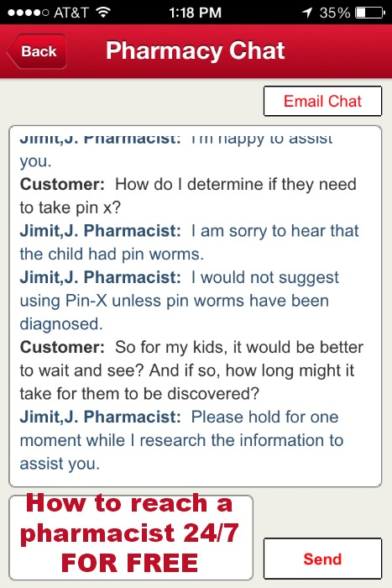
Chat
Big user base
User friendly
Conversation logging
Noise free
Ease of use
Feels like an active conversation
Go on hold without losing connection.

Slide 30

Apps
Other potential ways of electronic communication?

Slide 31
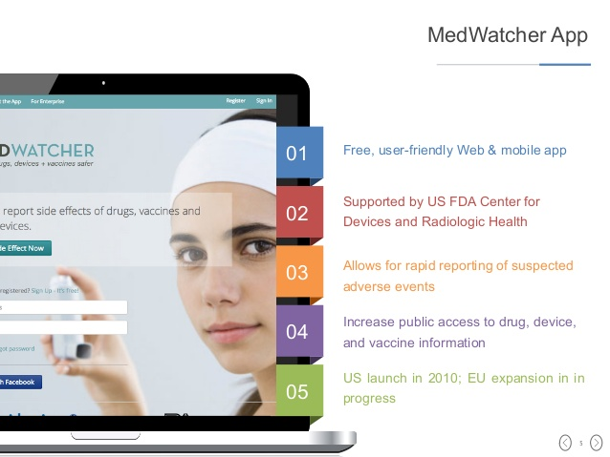

Apps
Imagine completing an adverse drug reaction form in an app…
It’s not only possible, it exists!
US: MedWatcher
UK/Netherlands/Croatia: Web-Radr

Slide 32

See you in the future!
Feedback, tips and comments to petter.wiken.dahl@helse-bergen.no

