Slide 1
Drug Information, Helsinki, Finland
Outi lapatto-reiniluoto, consultant in clinical pharmacology

Slide 2
Drug Information Centres in Finland
Helsinki
Turku
Helsinki: Poison Information Centre
  covers the whole country, only by phone
Helsinki: Teratologic Information Centre
  covers the whole country, only by phone

Slide 3
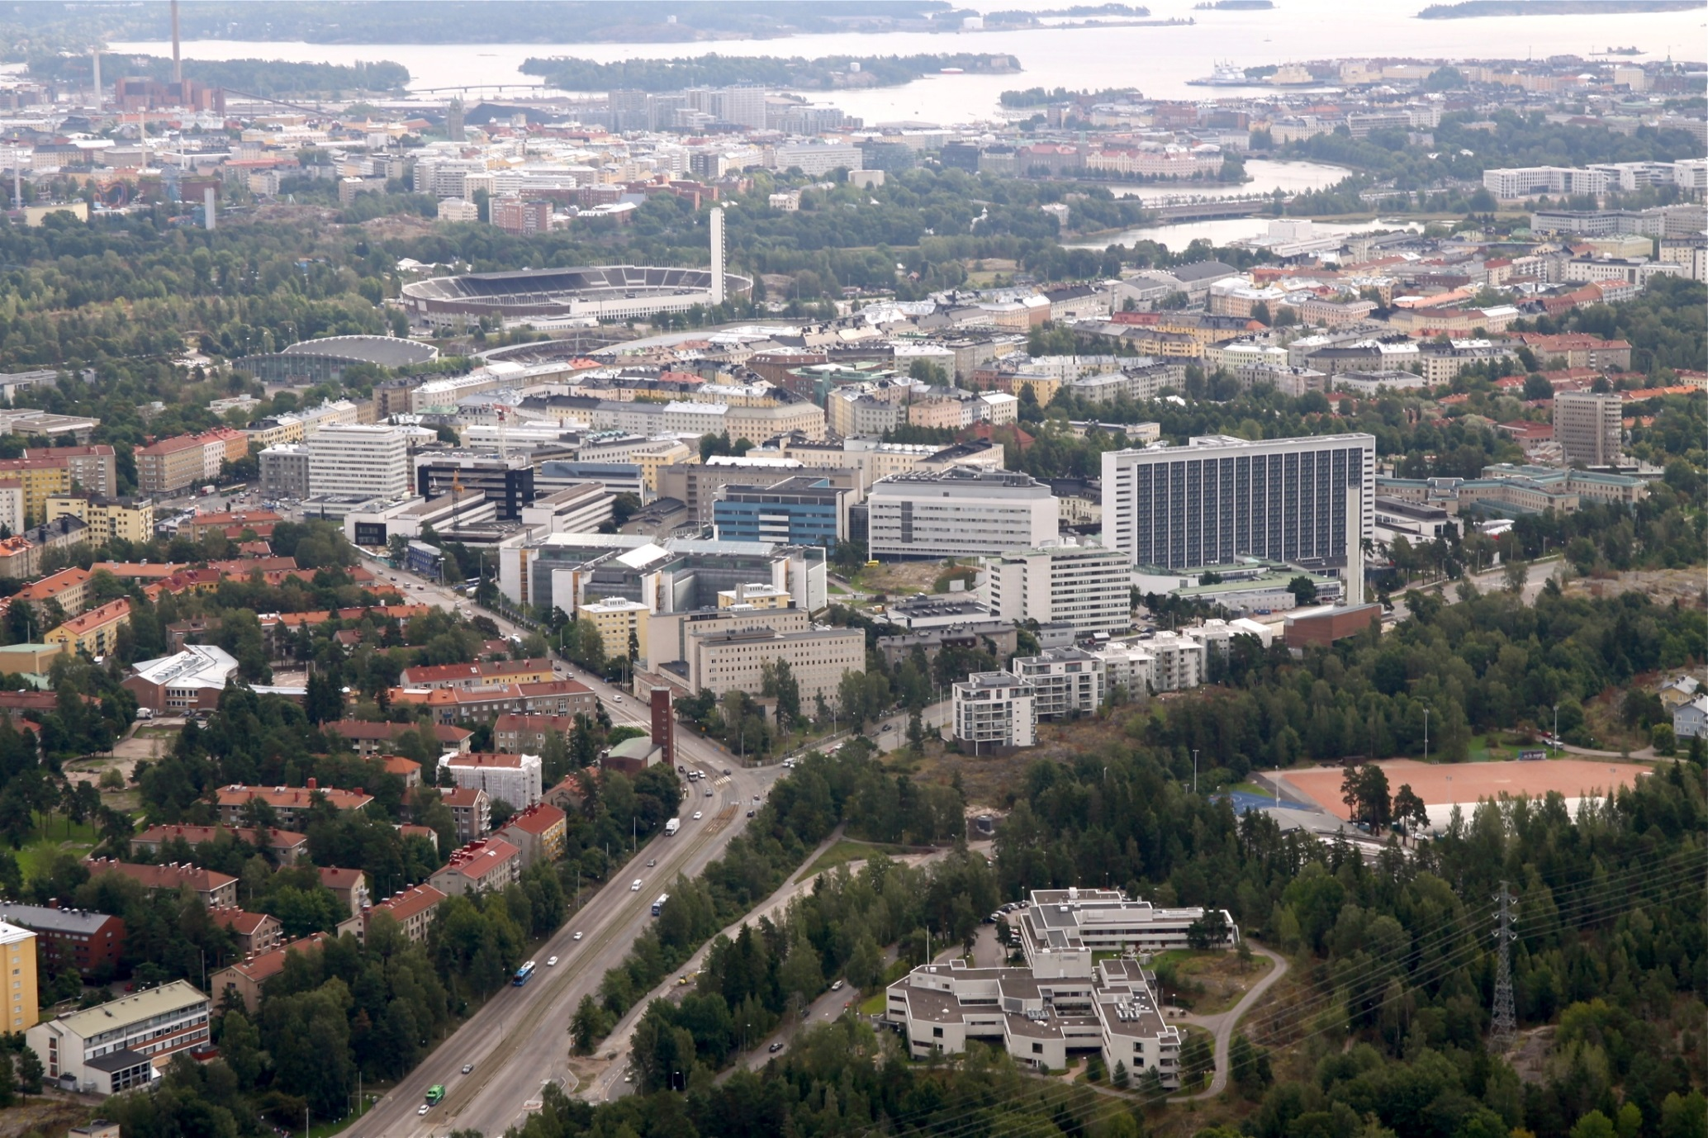
AMCH – Academic Medical Centre Helsinki

Slide 4
Clinical Pharmacology in helsinki
Helsinki University, Faculty of Medicine
Helsinki University Hospital
  Janne Backman: Professor in Clinical Pharmacology and Individual Medicine
  Mikko Niemi: Professor of Pharmacogenetics
  XX: Clinical teacher
  Outi Lapatto-Reiniluoto: Consultant in Clinical Pharmacology
  3-5 doctors preparing their thesis and / or specializing in Clinical Pharmacology
  (6-12 PhD students )

Slide 5
Funding
Part of University
  state funding
Part of Hospital
  municipal funding
(Research Funding)

Slide 6
co-operation between different centres
Helsinki and Turku receive questions also from other parts of the country (hospitals / health centres)
Close relationship between H and T
  mainly scientific collaboration
  questions and answers taken care individually
Part of the specializing can be done also in Poison information centre (Helsinki)

Slide 7
Questions
2015: 105
2016: 133
2017 (18.9): 121
  questions about interactions, adverse effects, long QT-time etc
Questions about drug concentrations 1-8 / weekly
Poison information Centre: 35 000-40 000 calls / year
  backup for them
TERA: 6000 calls / year
Notes:
It will be about 180 at the end of this year

Slide 8
Becoming…
virtual Health village (Terveyskylä.fi)
  33 houses
  Lääketalo = Läkemedelhuset = House of medicin
    Helsinki and Turku building together
    information for patients and all citizens
    practical guides, consultations etc for professionals

Slide 9
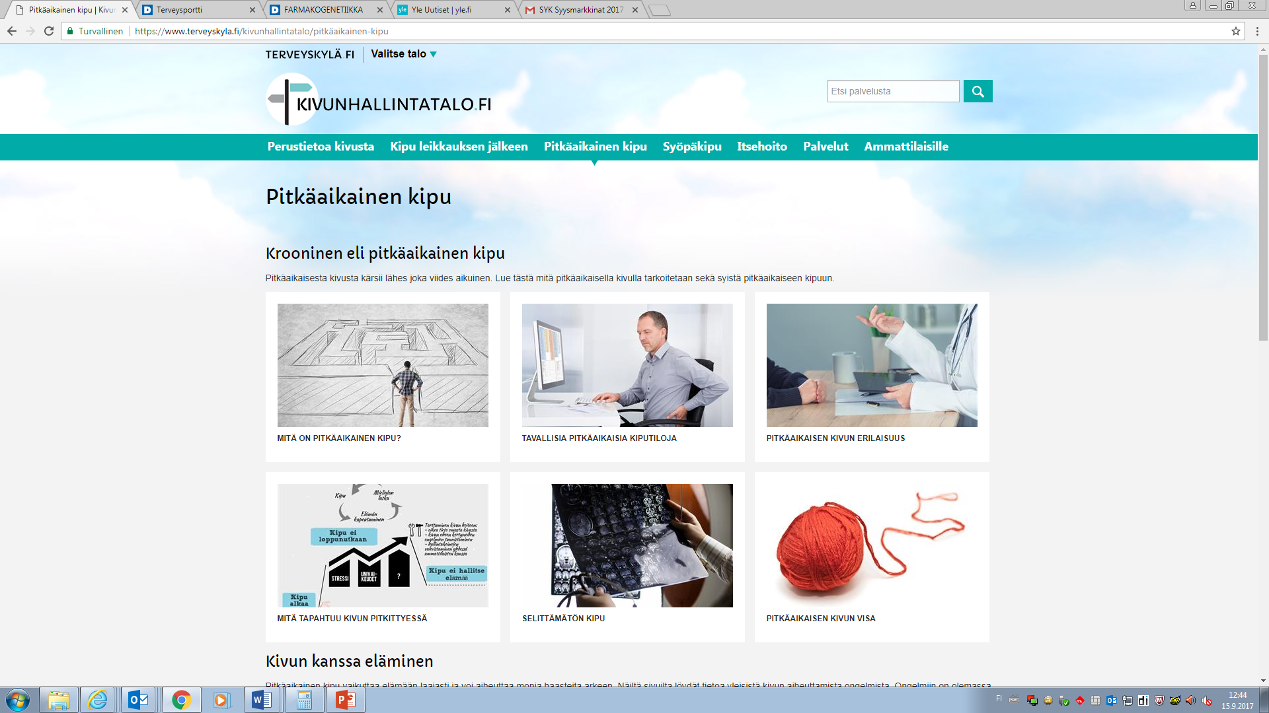

Slide 10
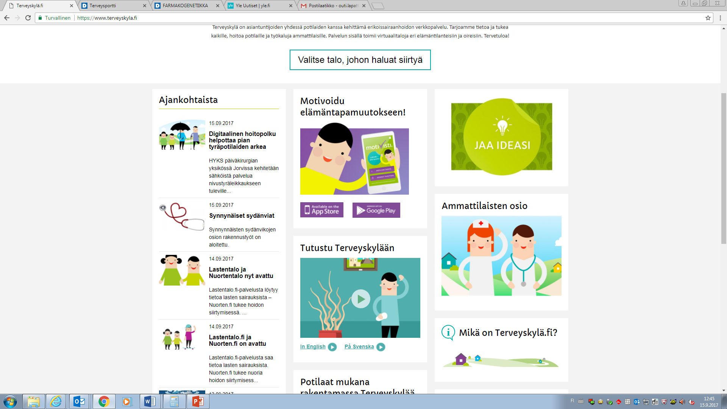
terveyskyla.fi

