Slide 1
Presenting RELIS
Trude Giverhaug
RELIS North

Slide 2
Regional Medicines Information & Pharmacovigilance Center
one RELIS-center in each of four regions
  located at regional university hospitals
  our own, common electronic resources (national network)
a total of 25-30 pharmacists, ~ 5 physicians/clinical pharmacologists, 1 IT-consultant, 1 secretary
one leader on each site, regular meetings
several and over time varying cross-centre project groups

Slide 4
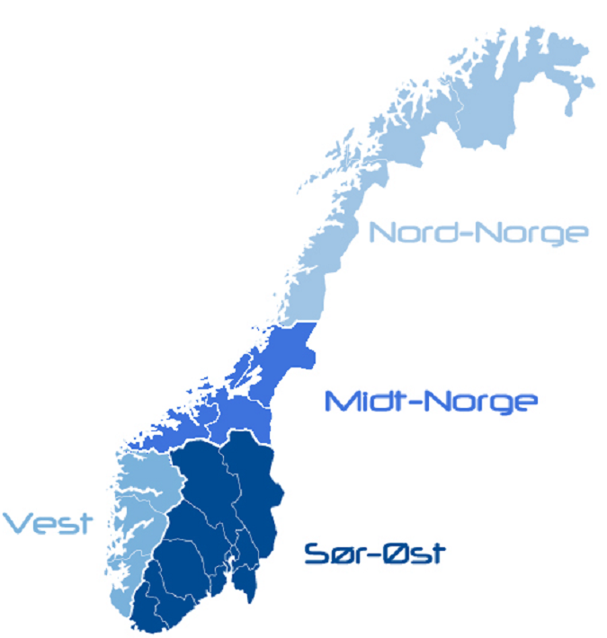
Organisation
Established stepwise from 1995 to meet the need for an independent medicines information service for health professionals
Funded by an unconditioned grant from the Ministry of Health and Care Services
Activity and accounts are reported to The Norwegian Medicines Agency
Tromsø
Trondheim
Oslo
Bergen

Slide 5
Core activities
answer medicine-related questions from health professionals concerning individual patients, or of more general character
handle and assess reports of suspected ADRs submitted by health professionals
since 2011: teratology information service for the public. Homepage:
www.tryggmammamedisin.no
from 2015: piloting Academic Detailing for GPs

Slide 6
Questions from health professionals

Slide 7
Pharmacovigilance
Norway has
5,5 mill inhabitants
22 000 physicians
3000 pharmacists
Challenge:
only 5 % of the serious ADRs are reported
(vaccine reports: Institute of Public Health)

Slide 8
Q/A from the public on use of medicines in pregnancy and breast feeding
www.tryggmammamedisin.no
Telephone call possible from 2016

Slide 9
Who asks RELIS?

Slide 10


Our net-based resources
RELIS home-page: www.relis.no (for health professionals)
  ask questions, report ADRs, read our articles, get information about RELIS courses and seminars
  search the database
    open access, free of charge
    Norwegian/Swedish language
    ~ 25 000 questions and answers available for external users
for the public: www.tryggmammamedisin.no
  read general texts on medicines in pregnancy and breast feeding
  get an individualized answer to your personal question
follow us on and
RELIS intranet

Slide 11





