Slide 1
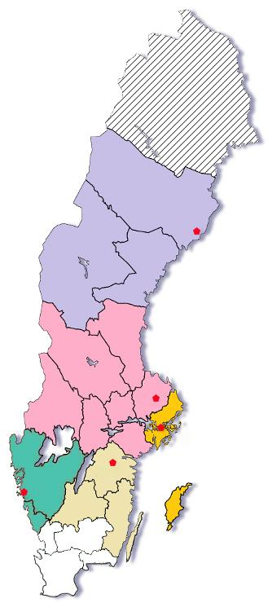
Drug Information
in Sweden
ELINOR (Umeå)
ULIC (Uppsala)
Karolic (Stockholm)
LUPP (Gothenburg)
LiLi (Linköping)
www.lic.nu
Notes:
5 centres, no centre in southest part of Sweden.

Slide 2
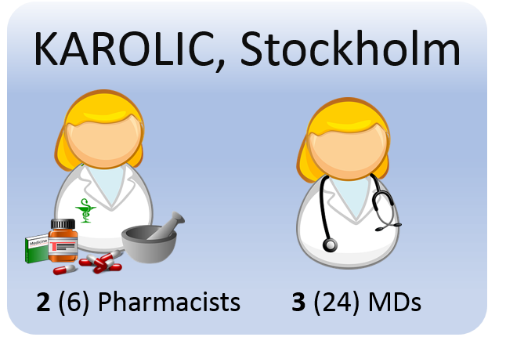
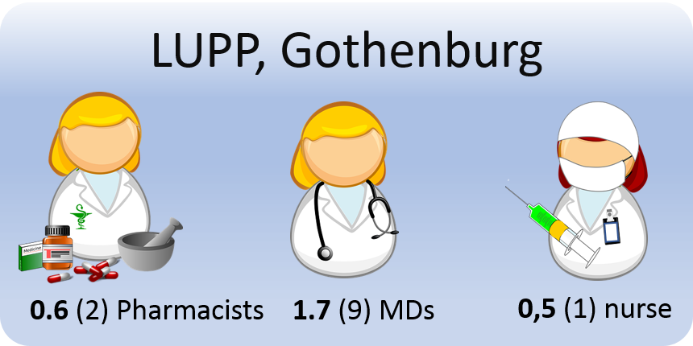
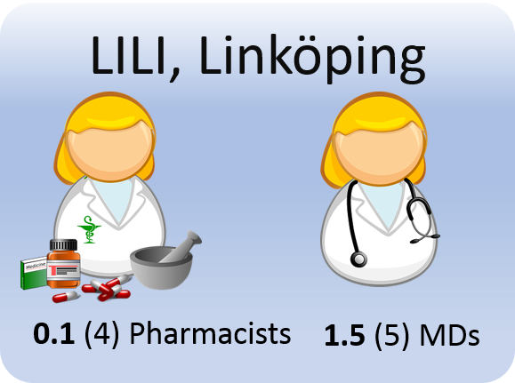
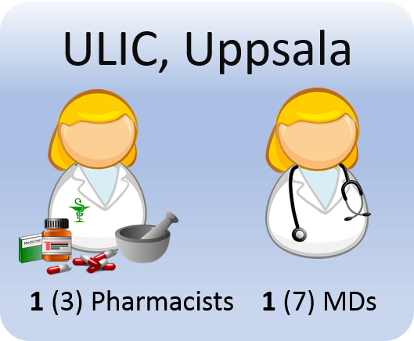
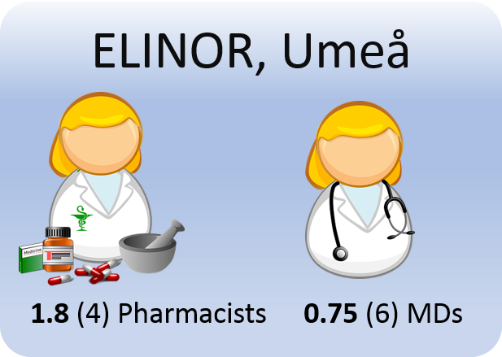
Notes:
A total of 14 persons woring in the Drug information centres (5,5 pharmacists, 8 physicians, 0,5 nurses). All financed by the county councils in the regions.

Slide 3
Questions 2016
Notes:
Susannah

Slide 4
Type of question

Slide 5

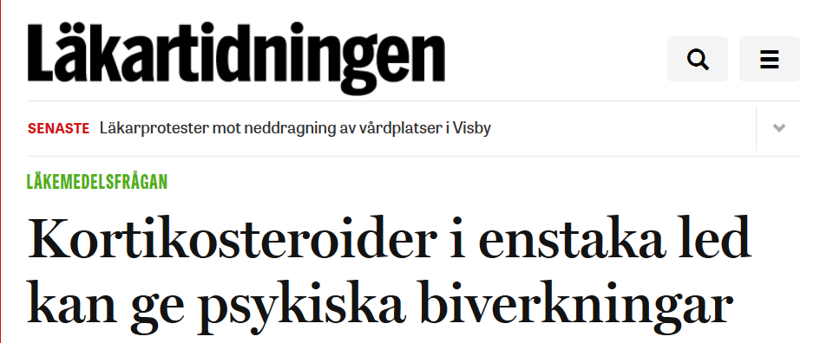

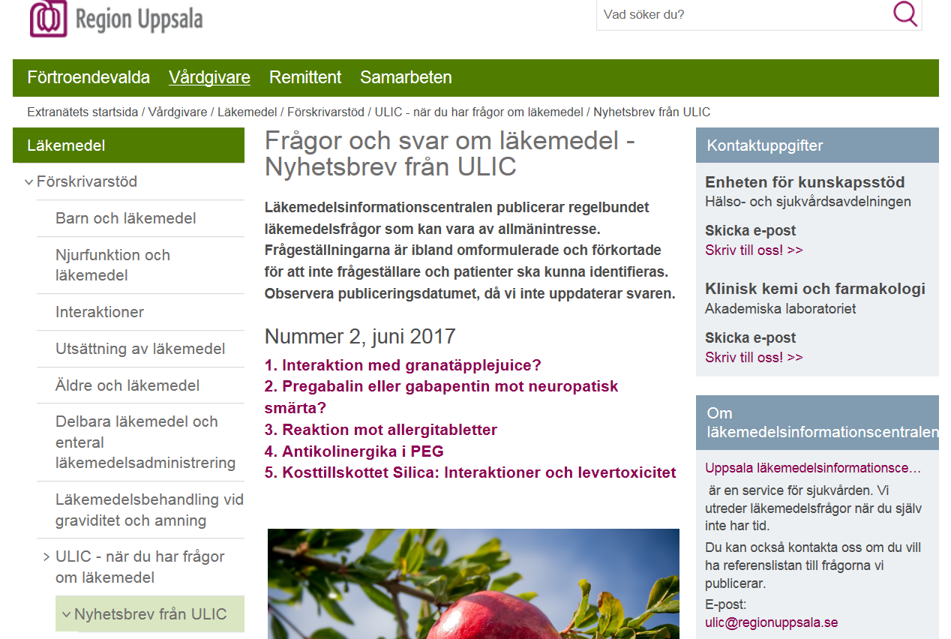
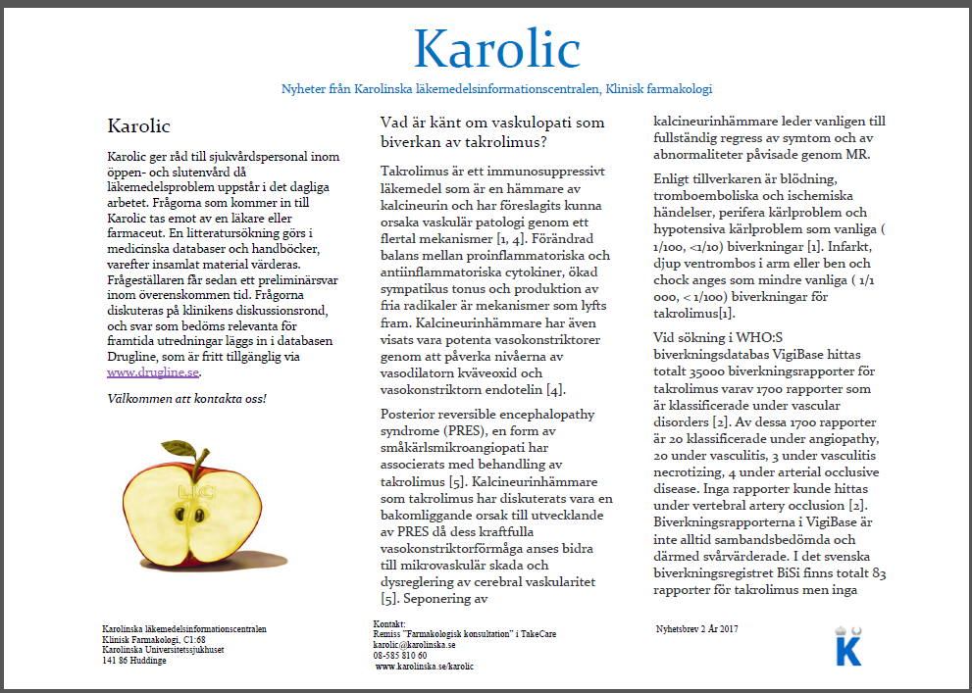
Publication of questions and answers
Notes:
Drugline/RELIS
Newsletters via mail
Läkartidningen

Slide 6
News from Sweden
Uppsala will use the Relis database
Umeå and Linköping have new members of the staff
Stockholm has made an easy time study

Slide 7
Easy time study
Time period: mars 27- may 26
157 questions (of 136 expected)
33.2 hours/day were used for Drug Information Centre work
Averege time/question = 8.7 hours

