Slide 1
50 years of Medicine Information from Hospital Pharmacies in Denmark
Medicine Information Centre
Allan Mikael Schrøder
M.Sc. Pharm., specialist in Hospital Pharmacy
Notes:
This year, hospital pharmacists in Denmark can celebrate that it is 50 years since the first dedicated position as information pharmacist was established

Slide 2
Medicine Information Centre
The Year was 1967
And in the year 2017
Ronald Reagan becomes governor in California
Military coup in Greece
Copenhagen celebrates the 800th anniversary
Sweden introduces the right-hand drive
The voting age is set to 20 years in Norway
South African heart surgeon Christian Barnard makes the first heart transplantation of history in human
The first dedicated position as information pharmacist is established at a hospital pharmacy in Denmark
Donald Trump – new president in US
Copenhagen celebrates the 850th anniversary
Norway started to shut down their FM Radio as the first country in the world
2017 is yet not finished so we don’t know…
Notes:
Let us look at the year 1967 and see what else happened this year

Slide 3
Congresses for Pharmacists
Medicine Information Centre
6th Nordic Congress of Hospital Pharmacy (1961)
FIP-Congress (International Pharmaceutical Federation) 1964
Notes:
Medicine information was not at topic on this two congresses.

Slide 4
Physician calls for medicine information
Medicine Information Centre
In 1958 the general physician Børge Stahl from Slagelse, Denmark received 2.353 letters by The Royal Danish Post. Of those 681 were advertisements from Medicine Companies
He argued for and called for impartial and independent drug information

Slide 5
A Swedish Survey
Medicine Information Centre
1961 a survey in the primary health care system showed that
  30 per cent of the patients didn’t take the prescribed medicine
  The storage at home was incorrect
  14 per cent had given her/his own prescribed medicine to other persons

Slide 6
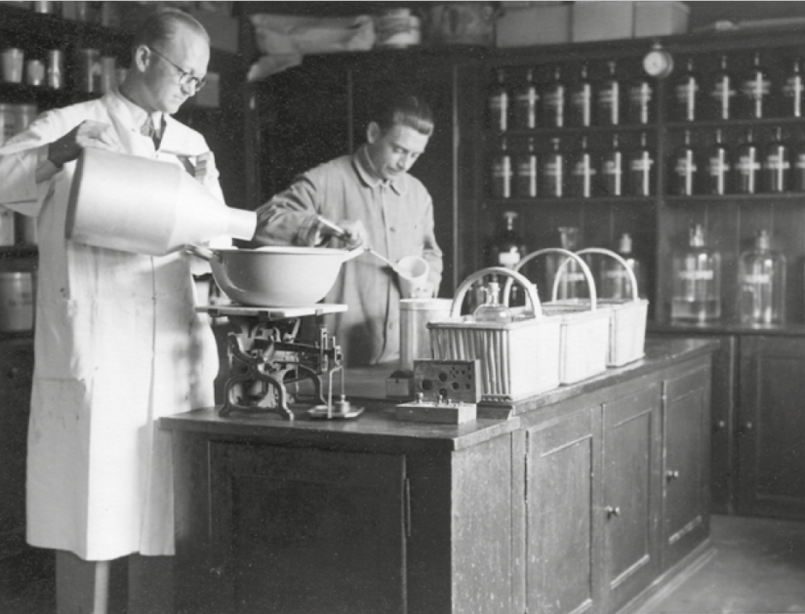
Historical development of Drug information at the hospitals pharmacies in Denmark
Medicine Information Centre
Before 1967
Very little contact between the staff at the Hospital Pharmacy and the Clinical Staff at the wards
The nurses brings prescriptions from the doctors to the Hospital Pharmacy in the morning and in the afternoon pick up the medicine which was produced or picked in the warehouse

Slide 7
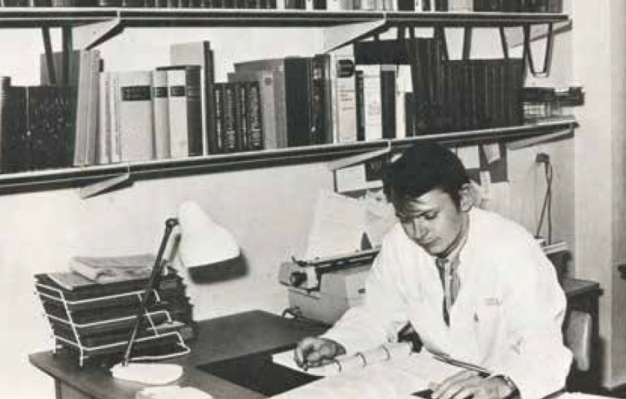
Historical development of Drug information at the hospitals pharmacies in Denmark
Medicine Information Centre
1967
  Price winning task, defining medicines/drug information, as information and communication containing an objective view of a certain problem, as opposed to advertising and propaganda
  Hospital pharmacy at Copenhagen Municipal Hospital establish an information department where a pharmacist has medicine information as the primary task
Notes:
Our union Pharmadanmark had held a competition i 1966 at the price wining task had described the need for objective medicine information.
At the photo you se Verner Fauerby who was the first hospital pharmacist in a postion as information pharmacist.

Slide 8
Medicines information evolution in Denmark – Hospital Pharmacy
1967
1992
1998
2007
1972
1996
2002
2009
1st drug information dept. established
BRSearch
implemented in Rigshospitalet’s
Pharmacy
National
Database SAID
Regions of Denmark were established as part of Danish Municipal Reform
Checklists and
file card system
Clinical pharmacology speciality established
National database project started
MedicinInfo
Notes:
This timeline shows you the development of medicine information
As I said before medicines information in Denmark is an old dicipline at the hospital pharmacies
More than 25 years after the first medicines information centre was established in Denmark The Danish National Board of Health recognized clinical pharmacology as a medical speciality back in 1996. Since then there has been drug/medicines information centres served by clinical pharmacologists at some hospitals and drug/medicins information centres at the hospital pharmacies.
The Regions of Denmark were created as part of the 2007 Danish Municipal Reform. The five regions replaced the former counties (amter).
The question is; what does the future holds??

Slide 9
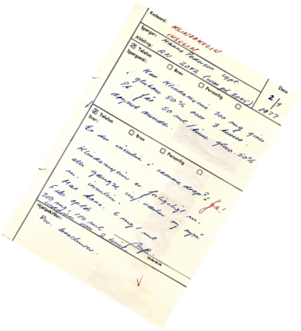
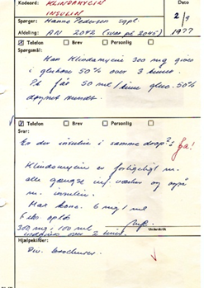
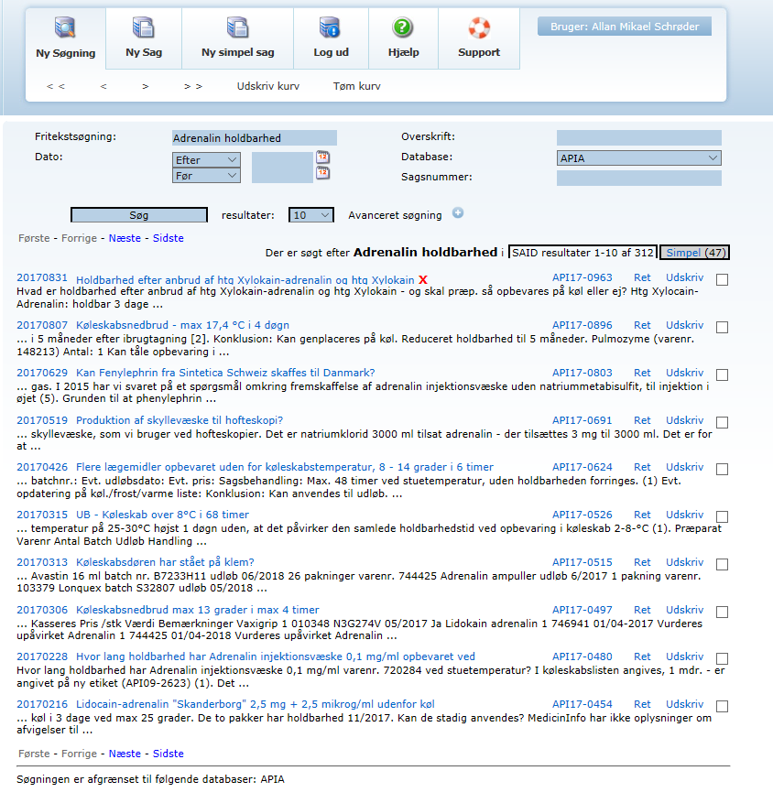
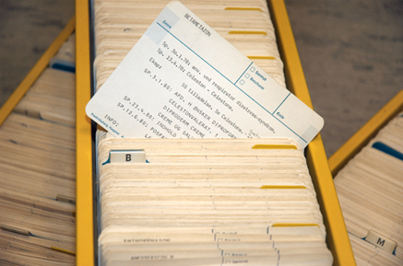
Database – then and now
Medicine Information Centre
1967
2017
Notes:
You see our old (2000) filing system with the the card index/index card
Our database SAID
Free text – data
No keyword

Slide 10
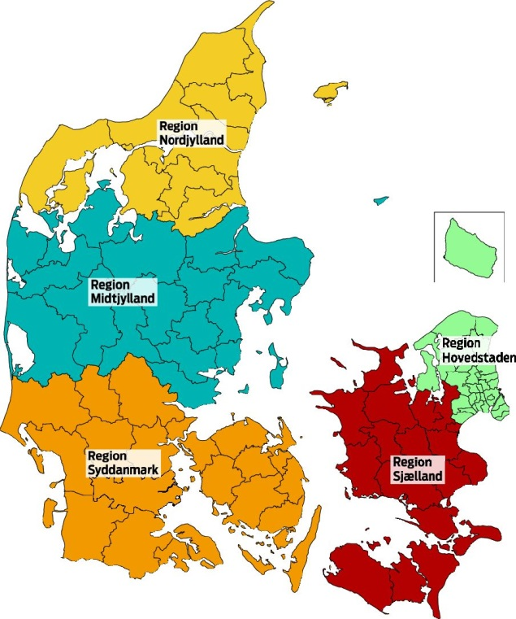
Medicine Information in Denmark 2017
Medicine Information Centre
The Hospital Pharmacy
at Central Denmark Region
The Hospital Pharmacy
at The North Denmark Region
Dept of Clinical
Pharmaclology
Dept of Clinical Pharmacology
University of Southern Denmark
The Hospital Pharmacy
South-West Jutland
MedicinInfo
The Capital Region
The Hospital Pharmacy
Hospital Lillebaelt
The Hospital Pharmacy
At Zealand Region
Dept of Clinical Pharmacology
Zealand Region
The Hospital Pharmacy
Sønderborg
The Hospital Pharmacy
Funen
Notes:
Drug information is provided from both clinical pharmacology departments and from the 8 hospital pharmacies
Drug information from hospital pharmacies are very differently organized
In Region of Southeren Denmark there are, for example, four hospital pharmacies, while in the other regions one is per region
In The Capital Region we have MedicinInfo

Slide 11
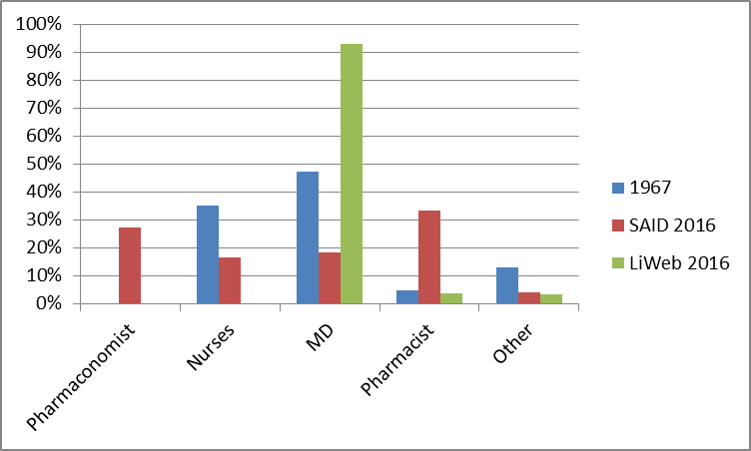
Who ask – then and now
Medicine Information Centre
Notes:
As you can se it was nureses and medical doctors who ask the information department at the hospital pharmacy in 1967
To day it is still nurses and medical doctors who are the two biggest groups of customers, but also clinical pharmacist and pharmacy technicians at ward level use our services

Slide 12
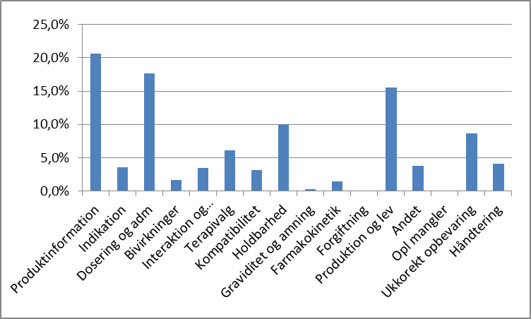
Enquiries to Medicine Information
1967
2017
Notes:
Enqueries i 1967: 362 and as aspected the number of enqueries was raised to 851 in 1972 and the pharmacy staff at the Medicine Information Centre i the Capital Region handel more than 1.900 enqueries in 2016

Slide 13
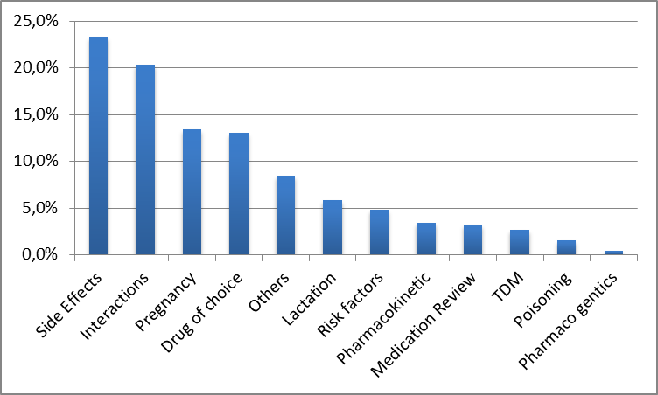
Enquiries answered by medical staff
Medicine Information Centre

Slide 14
Tasks at Medicines Information Centre
Medicine Information Centre
1967
  Medicines Information
  System for tablet identification
  Newsletter from the Hospital Pharmacies
  Statistics on drug consumption on each ward
  Information folder about drugs and services from the Hospital Pharmacy
2017
  Medicines Information
  ApoIntra – News of Medicine, web and intranet editor
  Drug Shortages
  EU tenders
  Specialist subgroups - Danish Medicines Council
  Food and Nutrition Committee - regional
  SAID-group - nationally
  Intravenous Dilution Guideline Database – nationally
  Patient safety
  Pharmacists on the emergency ward
  Education of hospital clinical staff
  Education: M.Sc. Pharm. and pharmaconomist
  Internal education of pharmacy employees
  Assessor of extemporaneous drug requests
Notes:
Today we've got a lot of databases and a completely different approach to medicines information than 25 years ago.
As you se the tasks have changed from something broader less knowledge-intensive to taskes which is more specialized and more knowledge-intensive

Slide 15

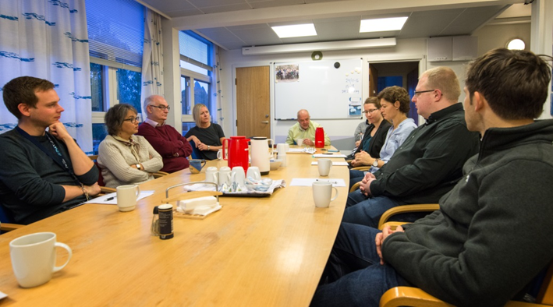
MedicinInfo anno 2017
Provides independent medicines information to healthcare professionals in the Capital Region of Denmark
Collaboration between Apotekets Information and clinical pharmacology established in 2009.
The quality of the answers are ensured by approval procedures and on daily staff meeting
Notes:
MedicinInfo is the only place in Denmark where there is a formal, structured collaboration/coorporation between what before was Hospital Pharmacy Medicin Information Centre and Clinical Pharmacology Information Centre
MIC was established in 2009 as the result of a political desicion: In the Capital Region there should be only one hotline where healthcare professionals could get help to questions/queries regarding medicines and the use of medicines
Queries from heathcare professionals including: doctors, nurses, pharmacists, pharmaconomist (Top-up service) and the last 3 years also from GP´s
The information is based on best evidence in relation/with respect to the individual patient or group of patients' clinical problems related to the rational use of medicines
The basic idea of MedicinInfo is to use the synergy of the interdisiplinary competencises (pharmacist/physician)
The morning conference is a central source of knowledge sharing and development. The queries are discussed and are looked upon with both “pharmacist/physicians eyes”

Slide 16
MedicinInfo databases
LiWeb
  Data from the 4 clinical pharmacology centers in Denmark
  13.715 queries aprox. 4.900 from the Capital Region
SAID
  Data from the 8 hospital pharmacies in Denmark
  34.727 queries aprox. 27.000 from the Capital Region
Notes:
Also contributing to the synergic effect is our databases:
SAID is a national database: All hospital pharmacies in Denmark uses this
Liweb is the common/national database for the clinical pharmacologists
All pharmacists an physicians working in MIC have acess to both databases. Pharmacists register in SAID, physician ind Liweb
Both databases were established before MedicinInfo was founded
LiWeb established in 1997, SAID in 2002
If you wonder why there is two database, one of the answers might be that MedicinInfo is the only formal coorparation between hospital info and clinical pharmacology – but hospital pharmacies and clinical pharmacology serve as medicines informations center throughout Denmark

Slide 17
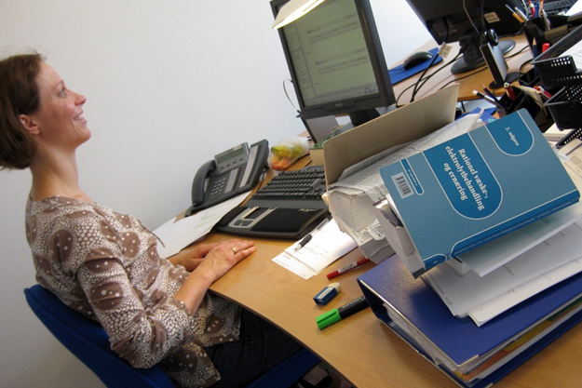
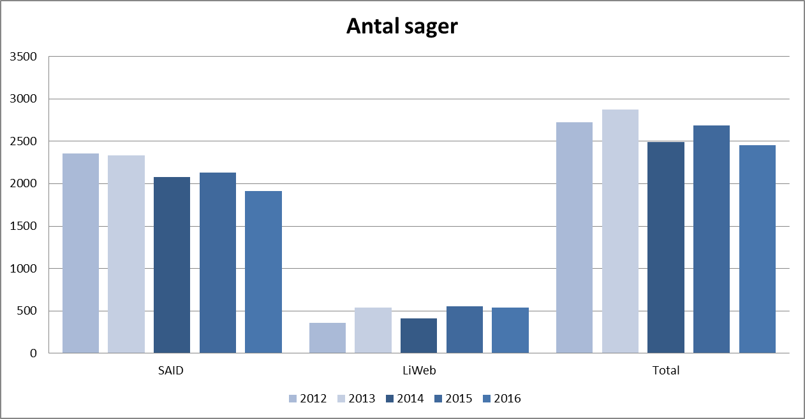
Enqueries to MedicinInfo
Numbers per year
Notes:
This slide shows the number of enqueries to MIC
As you can see the numbers are relatively stable.

Slide 18

Medicine Information Centre
The most important thing for the information pharmacists is to know something that nobody else knows ... ".

Slide 19
In MedicinInfo are the knowledge by clinical pharmacologist and hospital pharmacist an excellent synergy to give the best answer to our customers
Medicine Information Centre

Slide 20
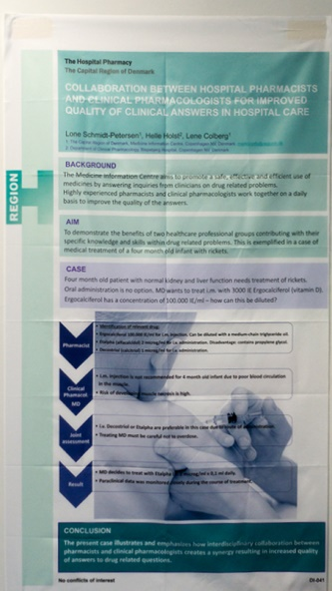
Medicine Information Centre

