Slide 1

Can we trust adverse effects data?
Nordic LIC Meeting, Oslo, 25-26. september 2017

Slide 2

Tone Westergren
Cand.pharm. Head of section RELIS Sør-Øst
E-mail: twesterg@ous-hf.no
Telefon: 23 07 54 39

Slide 3
Background
Clinical studies are designed with regard to measuring effect parameters
Several reports have found weaknesses in registration and reporting of adverse effects
What are the consequences for risk/benefit assessments?

Slide 4
So we should not be surprised…
50% of new medicines: Serious adverse effects discovered after marketing
3% withdrawn due to unacceptable safety profile.
10% get restrictions in marketing/use

Slide 5

Clinical trial: Assessment of adverse effects
Start
End
Analysis
Publi-
cation
Protocol
Inclusion

Slide 6
What you see published is not the trial
Patient case forms
Internal notes
Protocol
Interim reports
Selection, interpretation, condensation, generalization

Slide 7
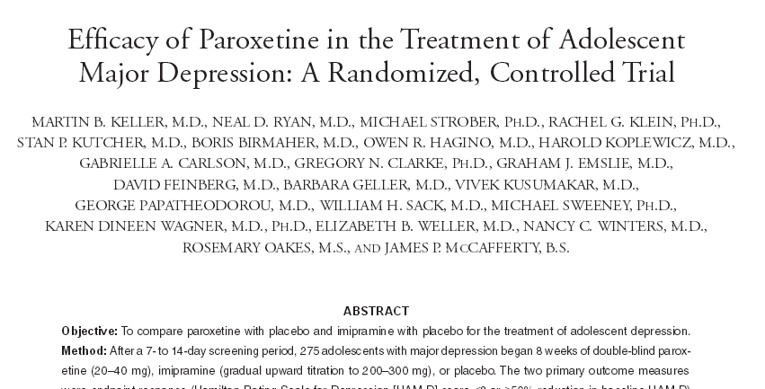
Study 329
Keller MB, Ryan ND, et al. Efficacy of paroxetine in the treatment of adolescent major depression: A randomized, controller trial. J Am Acad Child Adolesc Psychiatr 2001;40(7):762-72.

Slide 8
Studie 329
Adverse effects monitoring
Adverse events, heart rate, blood pressure, and body weight determined at each weekly visit.
Rhythm strip electrocardiograms (ECGs) were obtained at each visit, and 12-lead ECGs were obtained during screening phase and at weeks 4 and 8.
Routine clinical laboratory studies during screening phase and at week 8, or upon study withdrawal
If changes in cardiovascular parameters occurred, then dosage reductions were required

Slide 9
Original conclusion
Paroxetine demonstrated significantly greater improvement compared with placebo. The response to imipramine was not significantly different from placebo for any measure
Paroxetine was generally well tolerated. Most adverse effects were not serious. Described in table.

Slide 10
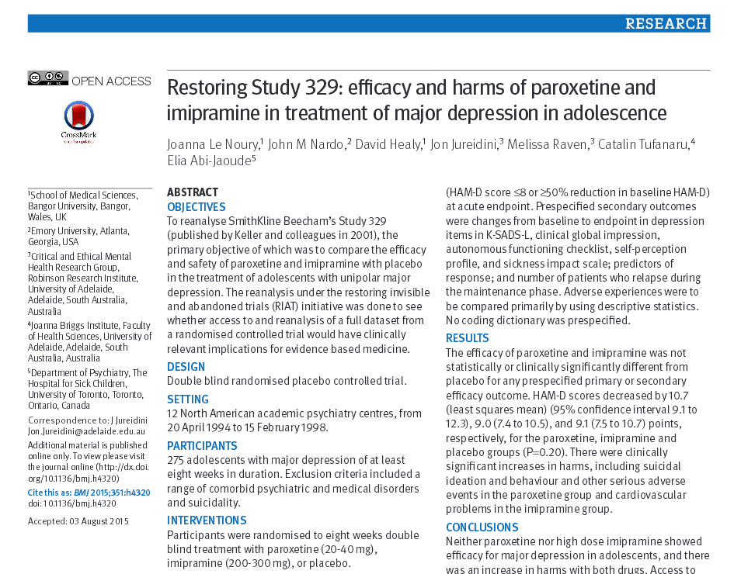

Slide 11
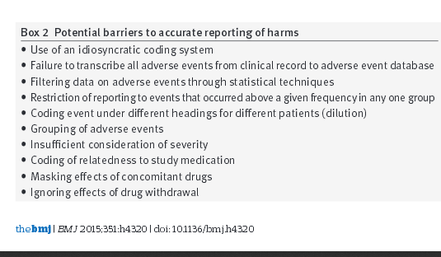
Barriers to correct reporting

Slide 12
Design
Study size
Which adverse effects to examine?
  All
  Some
  Unspecified
How to discover adverse effects?
  General examinations?
  Specific examinations?
  Subjective observations?
  Objective observations?

Slide 13
How will adverse effects be registered and reported?
Who decides what to report?
Who interprets and classifies the adverse effects into medical terms?
What will be included in the final publication? What is not included and why?

Slide 14
Faulty transcription process
”Firstly, several verbatim terms had been left uncoded into ADECS. Secondly, several adverse events found in the patient narratives of serious adverse events that led to discontinuation from the trial were not transcribed into appendix D”
Noury J, Nardo JM, et al. Restoring study 329: efficacy and harms of paroxetine and imipramine in treatment of major depression on adolescencs. BMJ 2015; 351: h4320.

Slide 15
Coding
Translation from verbatim to coding terms
Transcriptions between data sets
Linking of coding terms to superior level (organ system)
Restoring study 329

Slide 16
Coding and fragmentation
Choice of terminologi (MEDRA, other?)
Is headache a neurological or psychiatric adverse effect?
Suicide attempt:
  Suicidal ideation?
  Self harm/attempted suicide?
  Emotional lability?

Slide 17
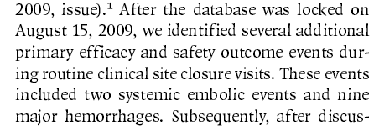
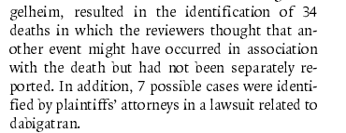
RE-LY: Dabigatran and warfarin
Connolly SJ, Ezekowitz MD, et al. Dabigatran versus warfarin in patients with atrial fibrillation. N Engl J Med 2009;361(12):1139-51
Connolly SJ, Ezekowitz MD, et al. Newly identified events in the RE-LY trial. N Engl J Med 2010;363(19):1875-6.
Connolly SJ, Wallentin L, Yusuf S. Additional events in the RE-LY trial. N Engl J Med 2014:371(15):1464-5.

Slide 18
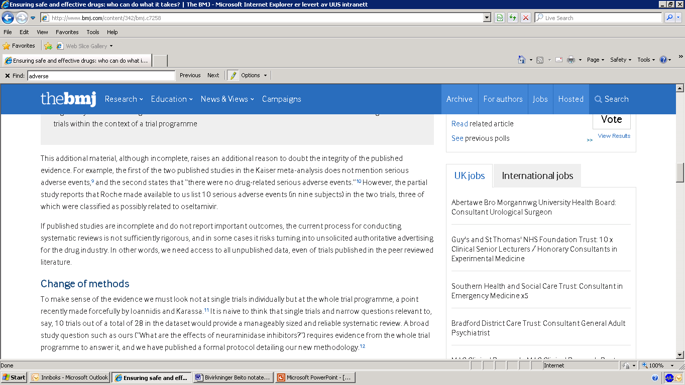
Interpretation and transcription: Oseltamivir (Tamiflu)
Jefferson T, Doshi P et al. Ensuring safe and effective drugs: who can do what it takes? BMJ 2011;342:c7258

Slide 19
Judgment variations?
”Patients were recruited from 951 clinical centers in 44 countries”
18 113 pasienter
Connolly SJ, Ezekowitz MD, et al. Dabigatran versus warfarin in patients with atrial fibrillation. N Engl J Med 2009;361(12):1139-51

Slide 20
Statistical and other filters
Only reports adverse effects that show statistical differences
Changes from continuous variables to dichotomy
Selection of outcome measures: Only some adverse effects mentioned

Slide 21
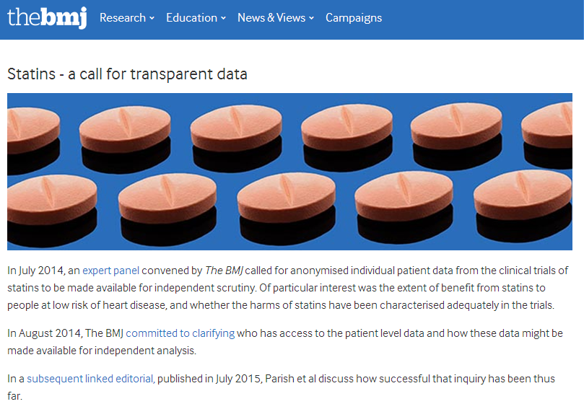
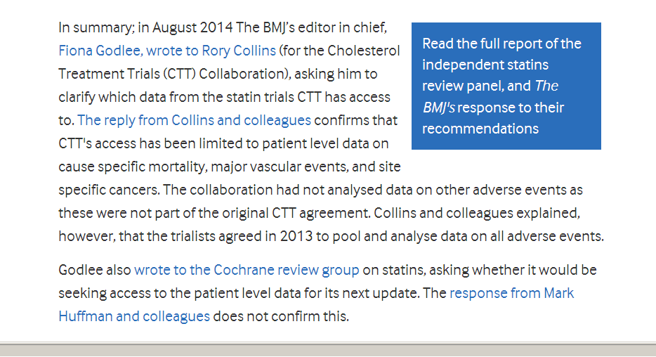

Slide 22
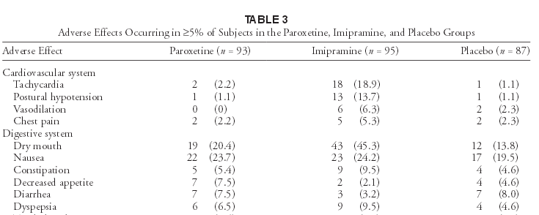
Limiting by frequency
Keller MB, Ryan ND, Strober M, et al. Efficacy of paroxetine in the treatment of adolescent major depression: a randomized, controlled trial. J Am Acad Child Adolesc Psychiatry 2001; 40: 152-67

Slide 23
Reporting on group level
Headache and dizziness included in central nervous system adverse effects. Result: Higher numbers, but serious events camouflaged.
Le Noury J, Nardo JM, et al. Restoring study 329: efficacy and harms of paroxetine and imipramine in treatment of major depression in adolescence. BMJ 2015;351:h4320

Slide 24
Serious adverse effect or not?
Are serious adverse effects reported separately?
Were there criteria in place for classification as serious?

Slide 25
Attribution: Was event caused by the medicine?
Attribution or relation to study drug was judged by investigator to be unrelated, probably unrelated, possibly related, probably related or related
”Notably, of the 11 patients with serious adverse events on paroxetine (compared with two on placebo) …..only one was considered by the treating investigator to be related to paroxetine”
Restoring study 329

Slide 26
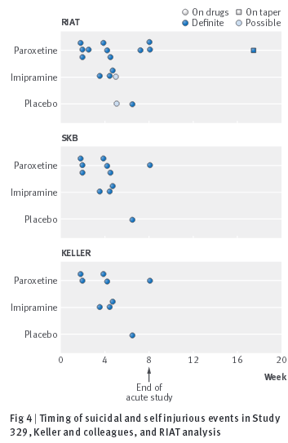
Different numbers in different data sets
Restoring study 329

Slide 27
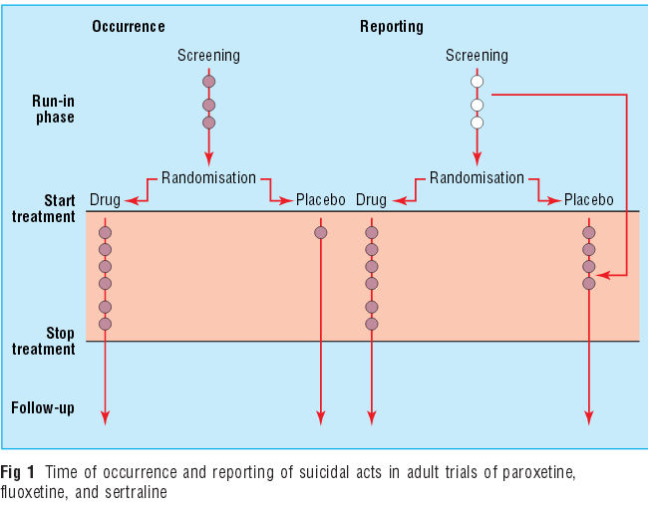
Suicide in SSRI studies
Healy D. BMJ 2006;333 (7558):92-5.

Slide 28
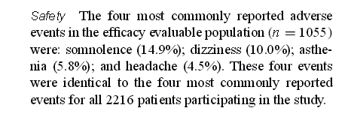
Gabapentin (Neurontin): STEPS
Morrell MJ, McLean MJ, Willmore LJ, et al. The Steps Study Group. Seizure 2000; 9 (4): 241-8.

Slide 29
Gabapentin (Neurontin): STEPS
No control group
No blinding
Diffuse inclusion criteria
Unclear outcome parameters
Most patients excluded from adverse effects assessment
Krumholtz SD, Egilman DS, Ross JS. Study of neurontin: titrate to effect, profile of safety (STEPS) trial: a narrative account of a gabapentin seeding trial. Arch Intern Med 2011; 171 (12): 1100-1

Slide 30
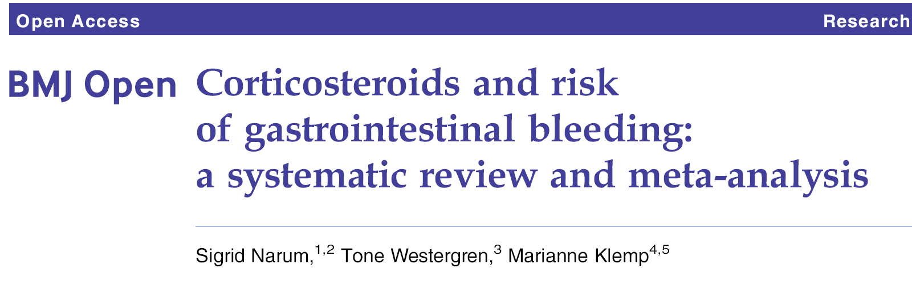
 | Total | Study found bleeding | Study did not find bleeding
Included studies | 159 33 253 patients 59 diagnoses | 72 (45,3) | 87 (54,7)
Adverse effects poorly defined, examined, described
Limitations to specific adverse effects
BMJ Open 2014;4:e004587. doi:10.1136/bmjopen-2013-004587

Slide 31
What was counted as gastrointestinal bleeding?
Major episode of GI bleeding which required blood transfusion
GI bleeding
Hematemesis or melaena requiring transfusion
GI bleeding (clinically relevant bleeding with decreased serum Hb level)
Guaiac-positive stools
GI bleeding assessed by occult blood testing
Gastric ulcer with overt hemorrhage
GI bleeding defined as oral or rectal GI bleeding on visual inspection
Gross GI bleeding
Blood hemoglobin monitored to assess serious GI blood loss
Hematemesis
Tarry stool
Acute GI complications - GI bleeding requiring transfusion or fluid, intussusception, perforation or need for operative intervention.
No definition

Slide 32
How were patients monitored?

Slide 33
Descriptions of GI adverse effects
There were no complications in either group
  Fiesseler FW et al. Steroids for migraine headaches. J Emerg Med 2011; 40 (4): 463-8
The cause of death in both methylprednisolone recipients was gastrointestinal bleeding
  Carithers RL et al. Methylprednisolone therapy in patients with severe alcoholic hepatitis. Ann Intern Med 1989; 110: 685-90.
Only two patients suffered from a major episode of GI bleeding which required blood transfusion, one in the steroid group and one in the placebo group.
  Braakman R et al. Megadose steroids in severe head injury. J Neurosurg 1983; 58: 326-30
There were no differences in blood haemoglobin levels at any point in the five days after study
  Bernard GR et al. High-dose corticosteroids in patients with the adult respiratory distress syndrome. NEJM 1987; 317: 1565-70

Slide 34
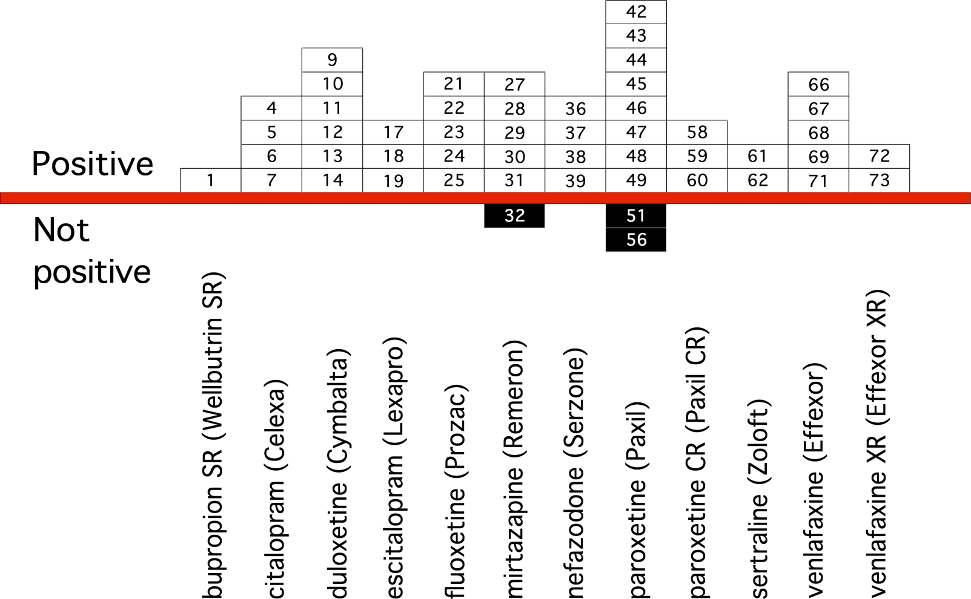
Publication bias: Visible studies
With permission from professor David Healy

Slide 35
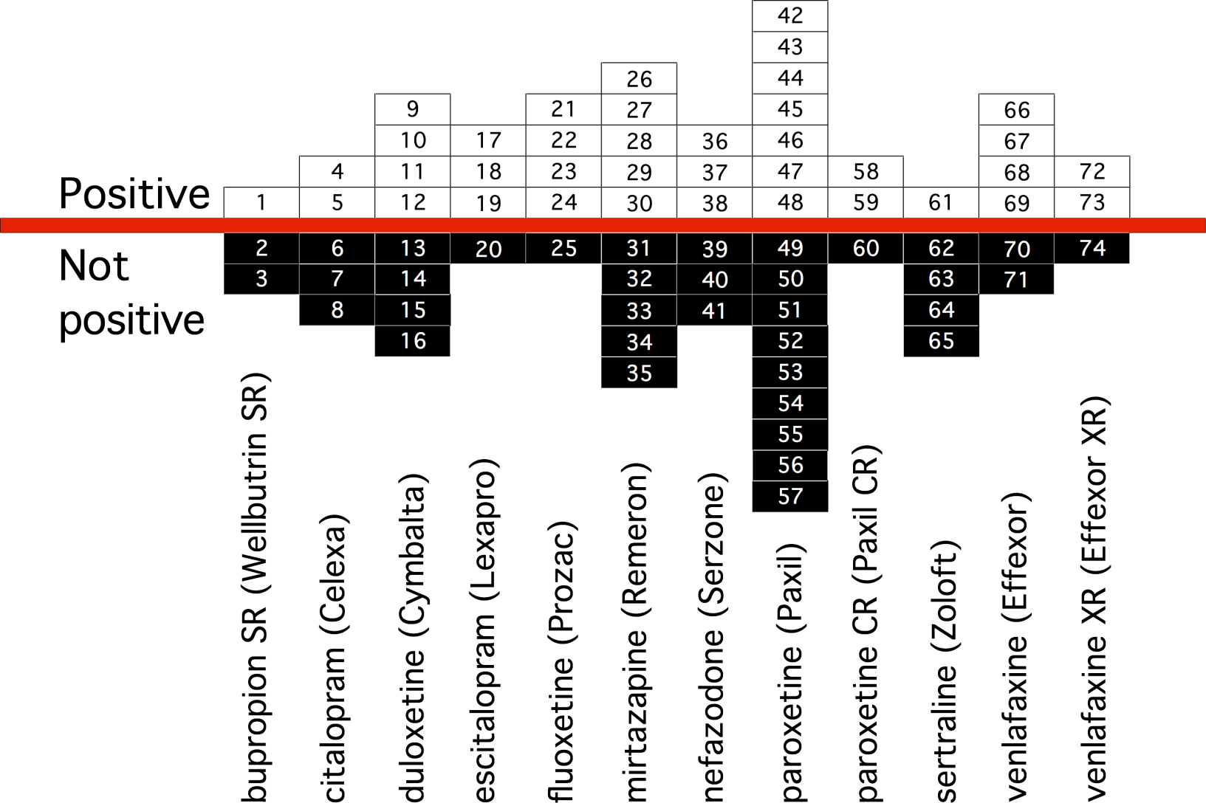
Publication bias: Incl. unpublished data

Slide 36
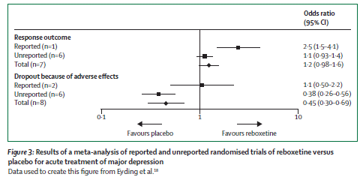
Systematic reviews – now what?
Chan AW, Song F, et al. Increasing value and reducing waste: addressing inaccesible research. Lancet 2014. http://dx.doi.org/10.1016/S0140-6736(13)62296-5.

Slide 37
Summing up:
Several variables contribute to misjudgment of risk
Too small and short studies
Heterogeneous patient monitoring
Diffuse adverse effect criteria
Room for interpretation, filtering and inaccuracies

Slide 38

www.relis.no
Produsentuavhengig legemiddelinformasjon for helsepersonell

